Slide 1
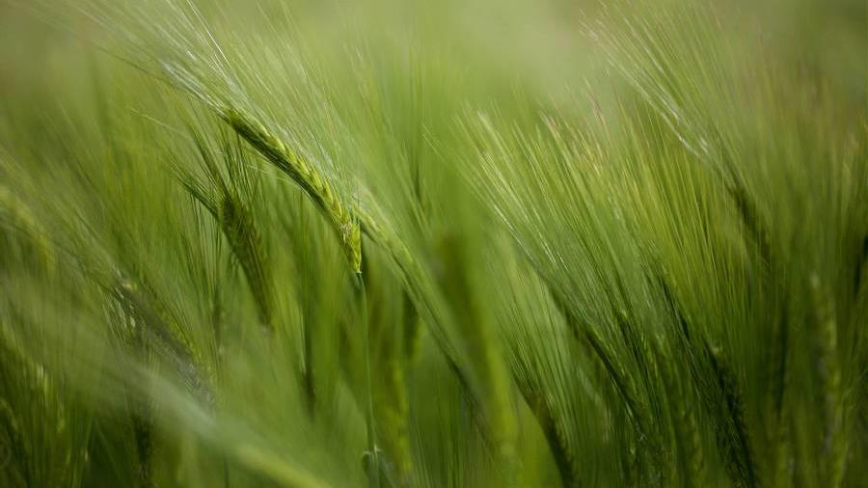
Cover sheet
​​

Slide 2
TEAM INFO
Faculty name :
Computer Science and Arterial Intelligent
Course name :
SELECTED TOPICS _2
TEAM NUMDER : 34
ENG. EMAN ISAMIEL
TIME : 10:00 TO 10:15 AM
ID | NAME
202000114 | إسراء شعبان السيد
202000155 | أمنية عرفات فهمي
202000183 | آية بهجت عبدالسلام
202000307 | رانا كمال أحمد البدري
202000487 | عائشة محمد أحمد عطية
202001003 | نور خالد علي سويفي

Slide 3
PAPER PRESENTATION
​​

Slide 4
CREATION
AUTHOR NAME :
KAI TIAN , JIEFENG ZENG , TIANCI SONG , ZHULIU LI , ASENSO EVANS , JIUHAO LI
PAPER NAME :
TOMATO LEAF DISEASES RECOGNITION BASED ON DEEP CONVOLUTIONAL NEURAL NETWORKS
PUBLISHER NAME :
JOURNAL OF AGRICULTURAL ENGINEERING
YEAR OF PUBLICATION : 2023

Slide 5

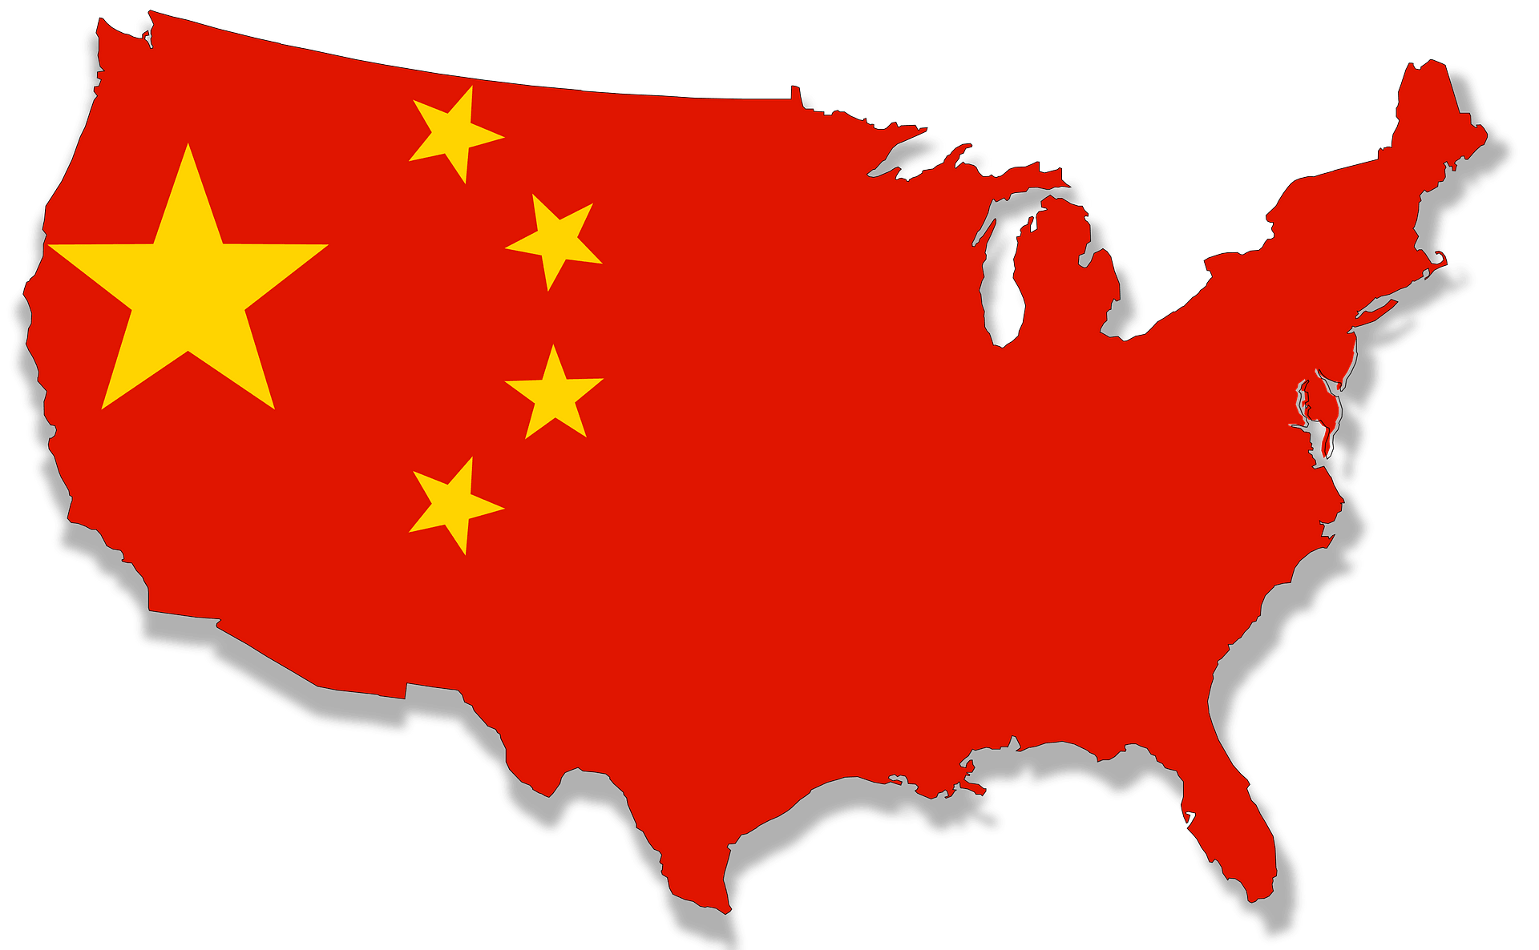

problem
According to the FAO (The Food and Agriculture Organization of the United Nations, FAOSTAT), China was the largest producer of tomatoes from 2013 to 2017. Diseases in tomato leaves cause major production and economic losses by reducing both the quality and quantity of productivity in the tomato industry.
So, in the paper will be shown that the researchers have done an app that recognize the type of tomato leaf’s disease better than plantix ( app that used to know the type of plants and so on ..) with a high accuracy than plantix .

Slide 6
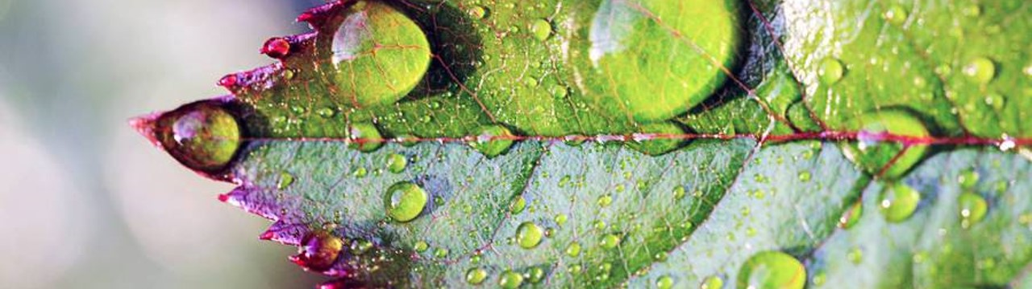
Dataset that used
To obtain a reliable CNN model, a large-scale dataset is essential. We used both in-house and public datasets of tomato disease leaf images in this work .

Slide 7
1st dataset
was acquired from the College of Water Conservancy and Civil Engineering greenhouse at South China Agricultural University .

Slide 8
2nd dataset
PlantVillage data (Hughes et al., 2015), was an open-access dataset with more than 50,000 images of leaves, from which we extracted 18,160 images of 10 different tomato leaf classes.

Slide 9
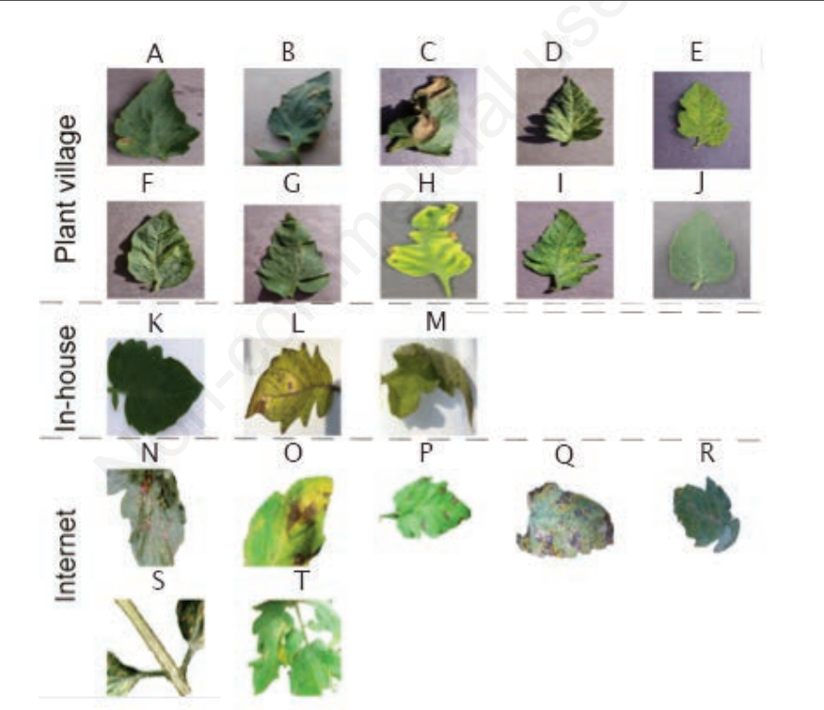
Samples of dataset

Slide 10
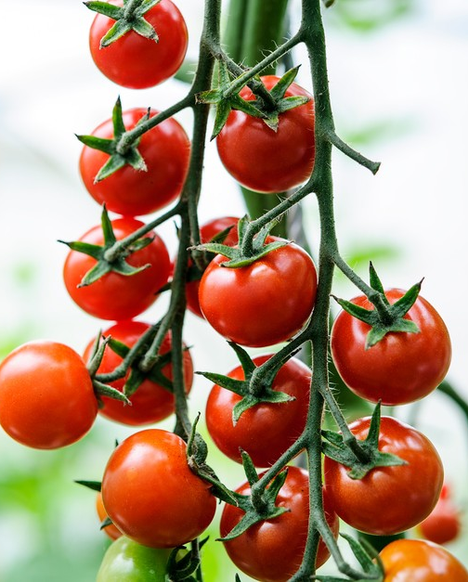
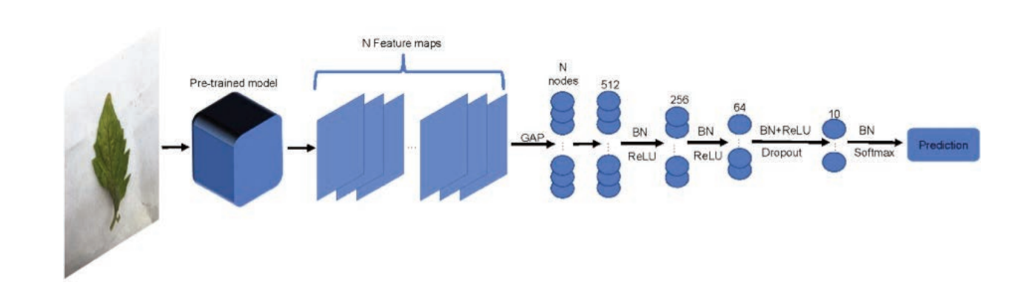
Algorithm that applied :
A multi group of Deep CNN has been used ​cause of its high ability to the advanced features from the image .
Then use the output from CNN into different pre-trained models such as ( ResNet , DenseNet , Inception ,… ) .

Slide 11
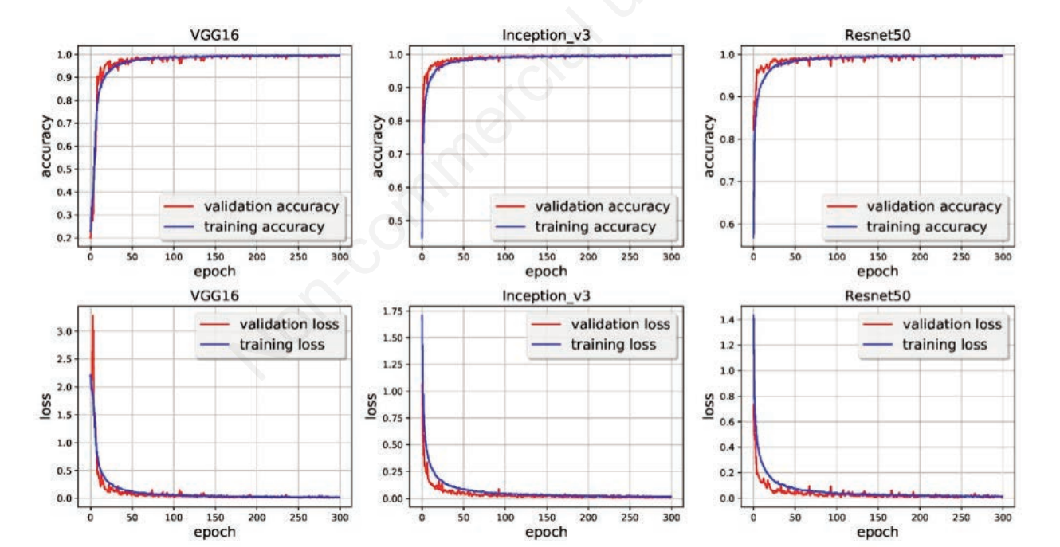
results
As diagrams provide that the accuracy getting higher without overfitting along with no of epochs that done in pre-trained models .
In the other hand , the loss getting lower along with no of epochs too .

Slide 12
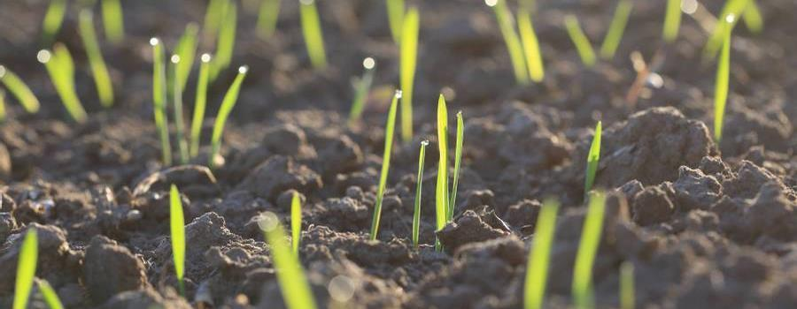
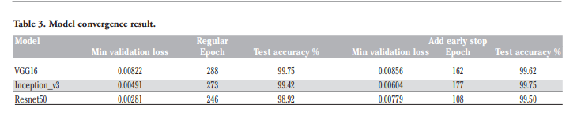
Results

Slide 13
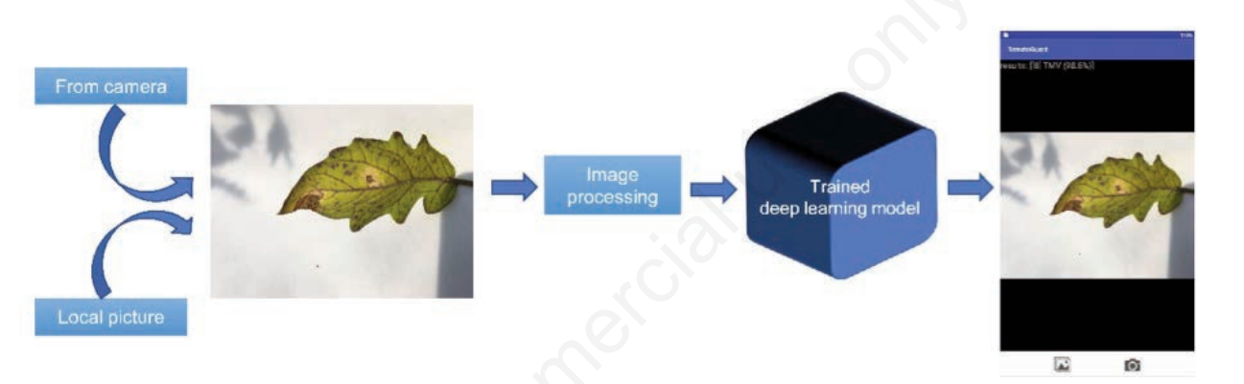
The input tomato leaf image needs to undergo image processing to divide all pixel values by 255 to meet the training model data requirements. Image processing steps are done automatically.
The identification of tomato disease types and confidence levels are quickly displayed above the image. At present, there is only one similar APP in Google Play called Plantix.
It claimed that it could detect more than 200 diseases covered from more than 40 crops, including 10 kinds of tomato leaf images discussed in this work.
However, since some of the test set in this work was augmented from some of the training set, the test set was unsuitable for testing Plantix. So, we collected 127 more new images, including 10 classes mentioned above from multi-sources for comparing with Plantix strictly .
Results

Slide 14
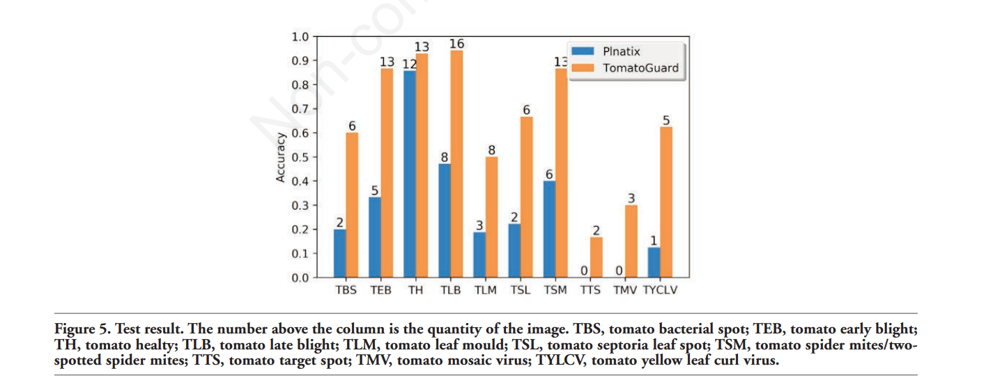
In this diagram :
The difference in the accuracy between PLANTIX application and TOMATOGURD application _which done by algorithm _ .
Results

Slide 15
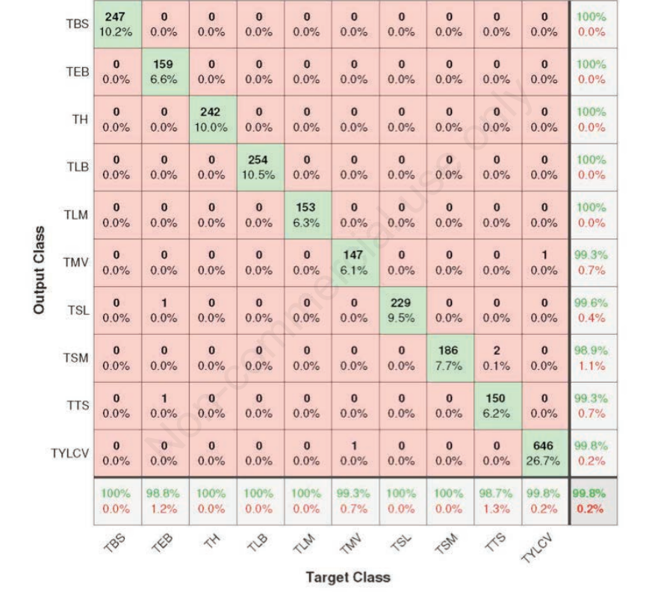
Confusion matrix

Slide 16
Project description document
​​

Slide 17
GENERAL INFO ON THE SELECTED DATASET
DATASET NAME :
TOMATO LEAF DISEASE DETECTION
DATASET LINK :
Tomato leaf disease detection | Kaggle
TOTAL NO OF SAMPLES IN DATASET:
14079
THE DIMENTION OF IMAGES :
256 x 256
NO OF CLASSES :
10 CLASSES
LABELS NAME :
Tomato_Bacterial_Spot
Tomato_ Early_blight
Tomato_healthy
Tomato_late _blight
Tomato_leaf_Mold
Tomato_Septoria_leaf_Sopt
Tomato_Spider_mites_Tow-Spotted_Spider_mite
Tomato_Target_spot
Tomato_mosaic_virus
Tomato_Yellow_Leaf_Crul_virus

Slide 18
Implementation details
​​

Slide 19
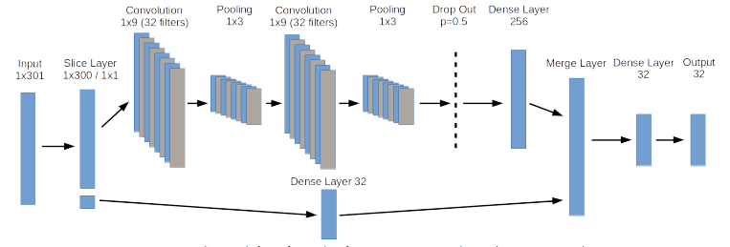
Implementation details
ratio:
TRAINING DATA : 80% VALIDATION DATA : 10% TESTING DATA : 10%
NO OF IMAGES IN EACH RATIO :
TRAIN DATA : 11263 VALIDATION DATA : 1408 TEST DATA : 1408
Block diagram for implemented algorithm :
cnn:

Slide 20
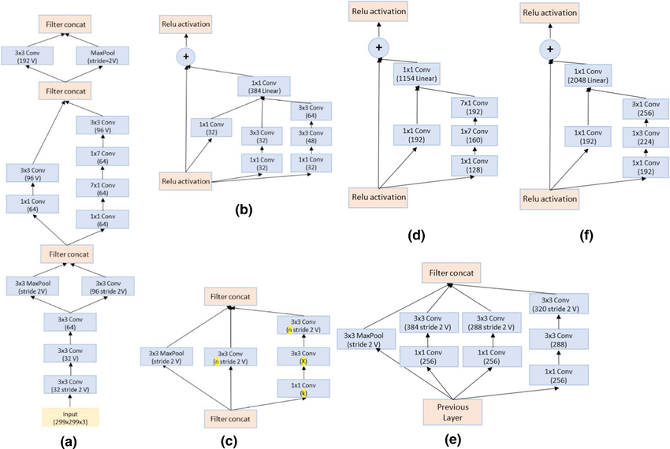
Implementation details
Block diagram for implemented algorithm :
inception_v2 (pre-trained model):

Slide 21
Implementation details
Block diagram for implemented algorithm :
hyperparameters :
LEARNING RATE : 0001
EPOCHES : 100
IMAGE SIZE : ( 112 , 112 )
BATCH SIZE : 32
ACCTIVATION FUNCTION : RELU , SOFTMAX
OPTIMIZER : ADAM

Slide 22
RESULTS DETAILS
​​

Slide 23
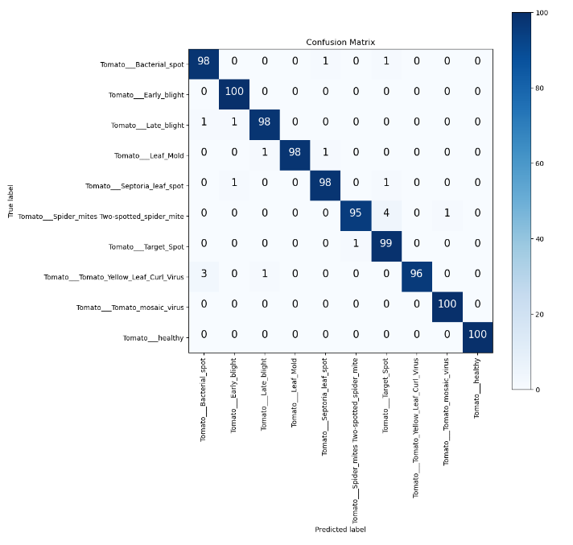
RESULTS details
EVALUATION THE MODEL :
CONFUSION MATRIX :
ACCURANCY :
TRAIN DATA : 99%
TEST DATA : 98%
OPTIMIZATION OF THE MODEL :
WE USED THE BEST NEURONS FROM CNN MODEL AND SAVE IN CHECKPOINTS AND PASS THEM TO PRE-TRAINED MODE (INCEPTION)

Slide 24
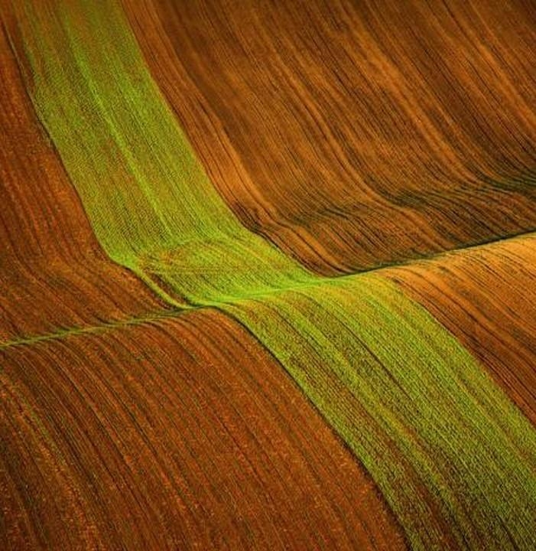
Thank you

